Slide 1


Titolo presentazione sottotitolo
EMBEDDED SYSTEMS PROJECT
Milano, XX mese 20XX
Maitan, Medvedec, Megler, Paone

Slide 2
OUTLINE
INTRODUCTION
HARDWARE
GPIO
TIMER
INTERRUPT
SOFTWARE
DECODING
ENCRYPTING
ENCODING
TESTBENCH

Slide 3
INTRODUCTION
The project addresses the problem of a plaintext excryption using microcontroller based application.
The application is performing the following tasks:
Acquire plaintext input
Generate ciphertext using the Caesar cipher
Display outcome of the encryption using the output

Slide 4
INTRODUCTION
The project addresses the problem of a plaintext excryption using microcontroller based application.
The application is performing the following tasks:
Acquire plaintext input ➔ HARDWARE
Provide the Morse message using pushbuttons on the board
Generate ciphertext using the Caesar cipher ➔ SOFTWARE
Display outcome of the encryption using the output ➔ HARDWARE
Output the ciphertext Morse code using LEDs

Slide 5
HARDWARE
GPIO:
Both GPIOs located on the board are used
GPIO_0 ➔ communicates with LEDs
GPIO_1 ➔ bound to the pushbuttons
TIMER:
Systick timer is used to measure the time when a button press occurs in order to understand if the signal is long or short

Slide 6
HARDWARE
INTERRUPT:
Generates a signal event that stops the normal execution of the instruction flow
Each GPIO has its own handler in order to react to the events
GPIO_1 handler manages button presses
Systick handler is called when the timer expires

Slide 7
SOFTWARE
The software that takes care of receiving the input characters and handling them through a “pipeline” is composed of three main steps:
Decoding ➔ using Morse signals to build a word in a form of a string formed by ASCII characters
Encrypting ➔ takes the word and encrypts it with Caesar cipher
Encoding ➔ generates a set of Morse signals starting form the encrypted ASCII string

Slide 8
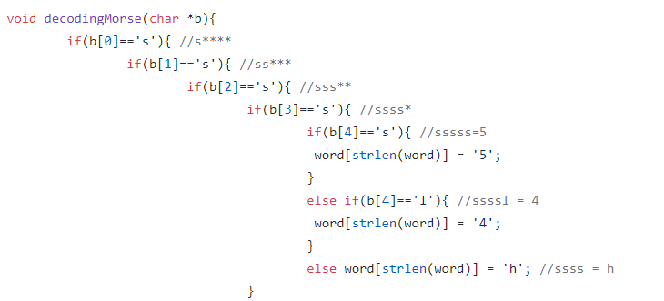
DECODING
Controller receives Morse code word through GPIO
Characters need to be converted to ASCII in order to be possible to manage and encrypt them
The following function decodes a single character :

Slide 9
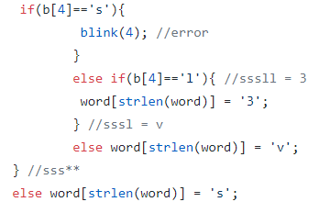
DECODING
The function works like this:
Pass the sequence of ‘s’ and ‘l’ characters to the function
Get to a leaf node corresponding to the ASCII character (or to an error)
Append the recognized character to the global variable called word

Slide 10
ENCRYPTION
Once all the ASCII characters corresponding to the input word have been recognized, the Caesar’s cipher with the key = 3 is used to encrypt it. Implementation of Caesar’s cipher requires:
Defining the alphabet (this alphabet has the length of 36)
Retrieve the position i of the character in the alphabet
Usin function strchr(alphabet, character)
Get the correct shifted character from the alphabet - (i+3)%36
Append the character to the translated word (global variable)

Slide 11
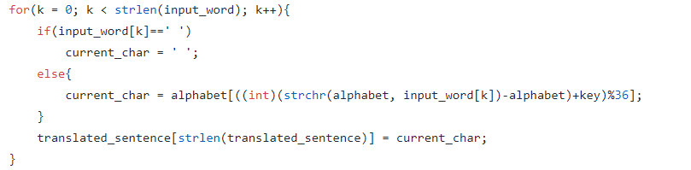
ENCRYPTION
This is done for every character of the input word:

Slide 12
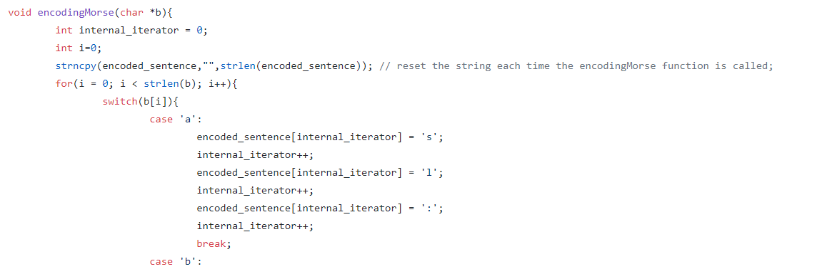
ENCODING
Ciphered word is now stored in the global variable. In order to be able to output it on a LED, it needs to be encoded again using Morse code.

Slide 13
ENCODING
At the end of the loop, the output word exists in two shapes:
Morse, stored in the global variable encoded_sentence
Ready for LED
ASCII, stored in the global variable translated_sentence
Ready for UART

Slide 14
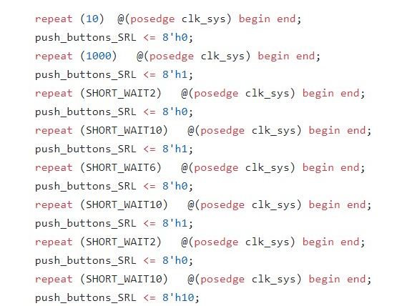
TESTBENCH
Several tests were made to check the hardaware’s behaviour with different inputs.
In the right picture the code of the button pressing simulation is shown. In this case the first button is pushed to generate the signals corresponding to the ‘R’ letter, and the third button to notify that the end of the character has been reached.

Slide 15
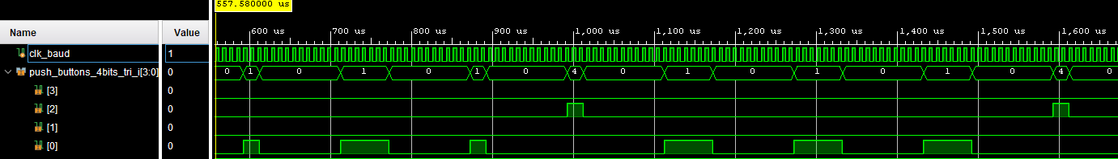
TESTBENCH
Sending the signals
The Morse code signals are sent by simulating the button presses
Short button presses (button 0) represent short signals (20us)
Long button presses (button 0) represent long signals (60us)
Short button presses (button 2) represent the end of the character
Short button presses (button 3) represent the end of the word
start 1 0 1 0 1 1 1 0 stop
Simulating characters ‘R’ and ‘O’ with different length button presses

Slide 16
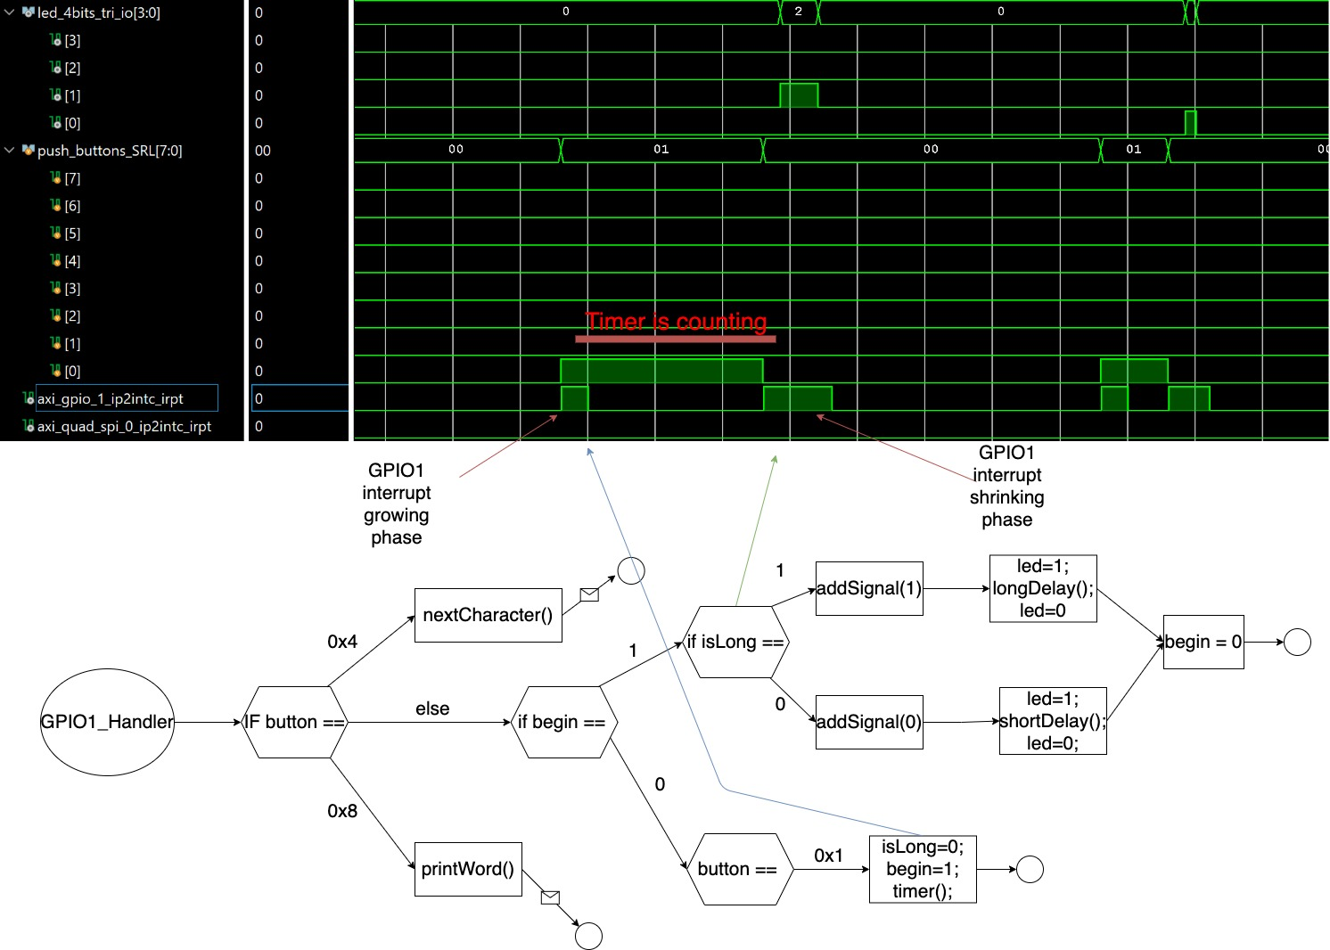
TESTBENCH

Slide 17
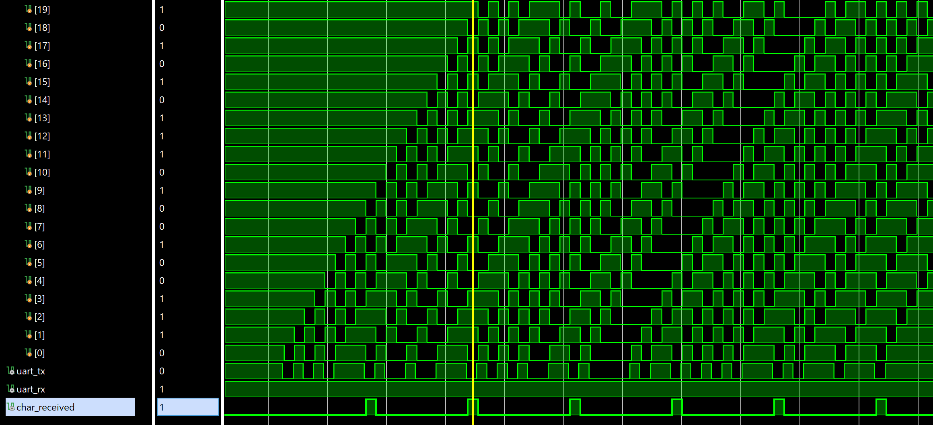
TESTBENCH
UART
The sequence of frames in UART protocol consists of:
Start / Stop bits ➔ 0/1
Data bits ➔ binary format of the character
The binary format of the character ‘U’ is read in the direction of the arrow: strating from the bit before the stop bit to the bit after the start bit
start 1 0 1 0 1 1 1 0 stop

Slide 18
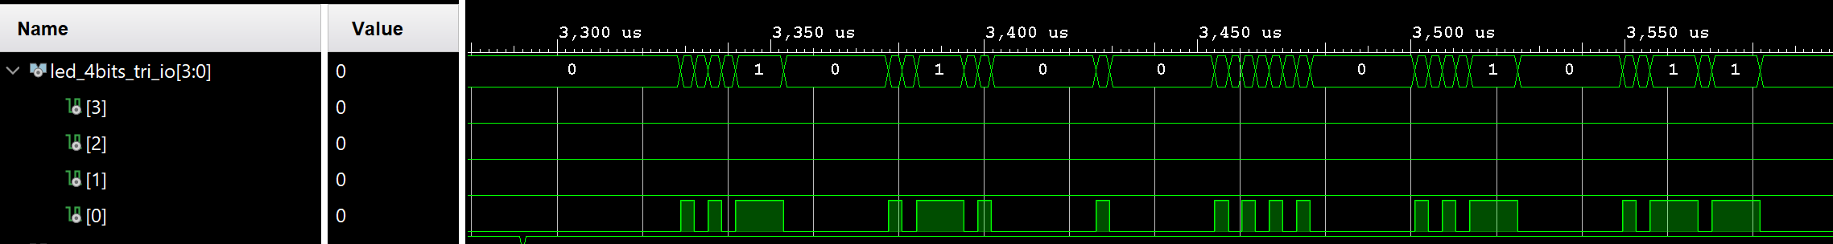
TESTBENCH
LEDs
LED sequence is being signaled by using the first LED (number 0)
Recevied Morse code word is ciphered (Caesar, key = 3) and outputed using Morse code
Short and long signals, longer pauses between the characters
Original word – ROBERT
Ciphered word - UREHUW
start 1 0 1 0 1 1 1 0 stop

